Slide 1

崑山科技大學 深度學習Deep Learning課程
technical report
報告人: 蘇偉哲 大學部
繳交日期:2020.3.31

Slide 2
Set up array( ) Methods and implementation
Python
內建的array()建立陣列
資料結構 上的 array List
import numpy as np x = np.array([[1,2.0],[0,0],(1+1j,3.)])
Array( ) array( )
1.使用Python內建的array()建立陣列
2.使用numpy提供的創建函數建立陣列
3.直接生成==>使用genfromtxt()方法建立陣列

Slide 3
Set up Array( ) Methods and implementation
Important attributes np.array() Methods and implementation
陣列的數量
import numpy
as np ar2=np.array([[0,3,5],[2,8,7]]) ar2.ndim
秩，即軸的數量或維度的數量
答案: 2
維度的數量
import numpy as np ar2=np.array([[0,3,5],[2,8,7]]) ar2.shape
陣列的維度，對於矩陣，n 行 m 列 答案: (2, 3)
Ndarray資料型態(dtype)與型態轉換
(astype)ar=np.array([2,4,6,8]);
ar.dtypef_ar=np.array([13,3,8.88])
f_arintf_ar=f_ar.astype(int)intf_ar
將資料轉成整數
變成整數答案: array([13, -3, 8])

Slide 4
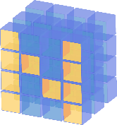
Numpy Attributes Create function
屬性 = np.zeros((2, 3)) | 實作範例 程式
Eye 生成对角矩阵 | import numpy as np ar9 = np.eye(3);
zeros 補0填充的陣列 | import numpy as np np.zeros((2, 3))
Ones 返回1指定的陣列 | import numpy as np np.ones((4, 7))
Linspace 返回num均匀分布的样本 | import numpy as np np.linspace(1., 4., 6)
Indices 陣列當索引取值 | import numpy as np np.indices((3, 3))
Diag 对角线或构造对角线数组 | import numpy as np ar10=np.diag((2,1,4,6));
Tile 数组複製 | import numpy as np a = np.array([0, 1, 2]) np.tile(a, 2)

Slide 5

生成对角矩阵
import numpy as np ar9 = np.eye(3); ar9
array([[1., 0., 0.], [0., 1., 0.], [0., 0., 1.]])
補0填充的陣列
import numpy as np np.zeros((2, 3))
array([[0., 0., 0.], [0., 0., 0.]])
返回1指定的陣列
import numpy as np np.ones((4, 7))
array([[1., 1., 1., 1., 1., 1., 1.], [1., 1., 1., 1., 1., 1., 1.], [1., 1., 1., 1., 1., 1., 1.], [1., 1., 1., 1., 1., 1., 1.]])
返回num均匀分布的样本
import numpy as np np.linspace(1., 4., 6)
array([1. , 1.6, 2.2, 2.8, 3.4, 4. ])

Slide 6

陣列當索引取值
import numpy as np np.indices((3, 3)
array([[[0, 0, 0], [1, 1, 1], [2, 2, 2]], [[0, 1, 2], [0, 1, 2], [0, 1, 2]]]))
对角线或构造对角线数组
import numpy as np ar10=np.diag((2,1,4,6));
array([[2, 0, 0, 0], [0, 1, 0, 0], [0, 0, 4, 0], [0, 0, 0, 6]])
数组複製
import numpy as np a = np.array([0, 1, 2]) np.tile(a, 2)
array([0, 1, 2, 0, 1, 2])

Slide 7

import csv import numpy as np x = ‘’‘1,3,2,3,1,2,3,4 第一行 2,4,5,0.6,5,6,7,8 第二行 3,7,8,9,9,10,11,12 第三行 4,1,1.1,1.2,13,14,15,16 第四行 ''' with open("abc.txt",mode="w",encoding="utf-8") as file: file.write(x)file.close()np.genfromtxt('abc.txt', delimiter=',', invalid_raise = False) Array ([[ 1. , 3. , 2. , 3. , 1. , 2. , 3. , 4. ], [ 2. , 4. , 5. , 0.6, 5. , 6. , 7. , 8. ], [ 3. , 7. , 8. , 9. , 9. , 10. , 11. , 12. ], [ 4. , 1. , 1.1, 1.2, 13. , 14. , 15. , 16. ]])
Use the genfromtxt ()
method to build the stack

Slide 8

NUMPY ndarray 運算(Array shape manipulation)
名詞 | 屬性
reshape | 重塑
ravel() | 陣列拉再一起
T | 改变数组形状
Newaxis | 多维数组增加一軸

Slide 9

NUMPY ndarray (N-Dimensional Arrays) Slice and operation
重塑
import numpy as np
y = np.arange(2,10).reshape(4,2)
array([[2, 3], [4, 5], [6, 7], [8, 9]])
陣列拉再一起
import numpy as np
ar=np.array([np.arange(1,6),np.arange(10,15)])
ar.ravel()
array([ 1, 2, 3, 4, 5, 10, 11, 12, 13, 14])

Slide 10
改变数组形状
import numpy as np
ar=np.array([np.arange(1,6),np.arange(10,15)])
ar.T
array([[ 1, 10], [ 2, 11], [ 3, 12], [ 4, 13], [ 5, 14]])
多维数组增加一軸
import numpy as np
ar=ar[:, np.newaxis]; ar.shape
Ar
array([[[ 1, 2, 3, 4, 5]], [[10, 11, 12, 13, 14]]])

Slide 11

NUMPY ndarray Operation
2*3--->3*2--->6*1
Array shape manipulation::reshape()
import numpy as np
x = np.arange(2,10).reshape(2,4)
x
y = np.arange(2,10).reshape(4,2)
y

Slide 12

NUMPY ndarray Operation
(Array shape manipulation)
import numpy as np
x = np.arange(2,10).reshape(2,4)
X 2到10 分2組4列
array([[2, 3, 4, 5], [6, 7, 8, 9]])
import numpy as np
y = np.arange(2,10).reshape(4,2)分4組2列
Y 2到10 array([[2, 3, 4, 5], [6, 7, 8, 9]])

Slide 13
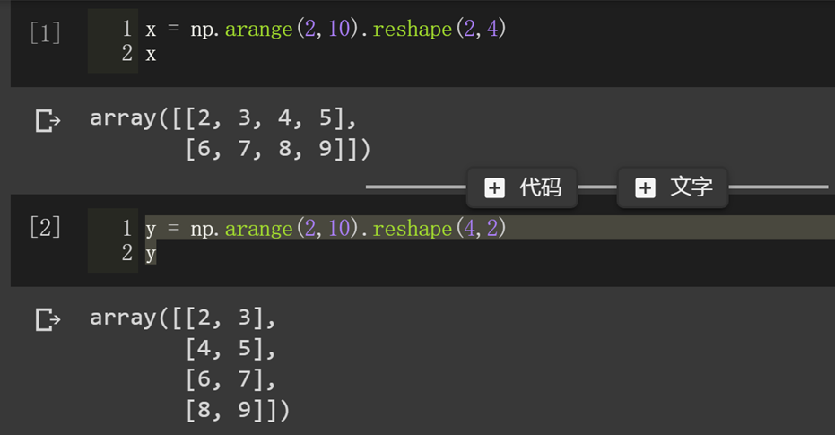
Array shape manipulation::reshape()

Slide 14
Slice operation
NUMPY ndarray (N-Dimensional Arrays)切片與運算
index
import numpy as np x = np.arange(2,10) # x print(x[0]) print(x[-2]) print(x[-1]) 2 8 9 | import numpy as np ar = np.array([[2,3,4], 第0行 [9,8,7], 第1行 [11,12,13 第3行 ]]) ar[1,2] 第1行第2列 7
import numpy as np
ar=2*np.arange(6)// 0到5 *2 所以到10
# ar array([ 0, 2, 4, 6, 8, 10])
ar[1:5:2]
array([2, 6])

Slide 15
Reduction operation
屬性 | 範例程式
prod() 乘積 | import numpy as np ar=np.arange(1,5) ar.prod()
sum() 相加方法 | import numpy as np ar=np.array([[2,3,4],[5,6,7],[8,9,10]]) ar.sum()
mean() 取均值 | import numpy as np ar=np.array([[2,3,4],[5,6,7],[8,9,10]]) ar.mean()
median(ar) 中位數 | import numpy as np ar=np.array([[2,3,4],[5,6,7],[8,9,10]]) np.median(ar)

Slide 16

Reduction operation
乘積
import numpy as np
ar=np.arange(1,5)
ar.prod()
24
取均值
import numpy as np
ar=np.array([[2,3,4],[5,6,7],[8,9,10]])
ar.mean()
6
相加方法
import numpy as np
ar=np.array([[2,3,4],[5,6,7],[8,9,10]])
ar.sum()
25
中位數
import numpy as np
ar=np.array([[2,3,4],[5,6,7],[8,9,10]])
np.median(ar)
6

Slide 17
Universal Functions:
Fast Element Wise Array Functions
計算数组各元素的平方根
import numpy as np
arr = np.arange(10)
np.sqrt(arr)
array([0. , 1. , 1.41421356, 1.73205081, 2. , 2.23606798, 2.44948974, 2.64575131, 2.82842712, 3. ])
計算数组各元素的指数值
import numpy as np
arr = np.arange(10)
np.exp(arr)
array([1.00000000e+00, 2.71828183e+00, 7.38905610e+00, 2.00855369e+01, 5.45981500e+01, 1.48413159e+02, 4.03428793e+02, 1.09663316e+03, 2.98095799e+03, 8.10308393e+03])

Slide 18
NUMPY ndarray Operation (operation between A matrix and B matrix)
加法運算
import numpy as np
arr = np.array([[1., 2., 3.], [4., 5., 6.]])
# arr
arr+arr
array([[ 1., 4., 9.], [16., 25., 36.]])
乘法運算
import numpy as np
arr = np.array([[1., 2., 3.], [4., 5., 6.]])
# arr
arr*arr
array([[2, 2], [2, 2]])
乘法運算
import numpy as np
ar=np.array([[1,1],[1,1]])
ar2=np.array([[2,2],[2,2]])
ar*ar2
array([[2, 2], [2, 2]])
dot運算
import numpy as np
ar = np.array ([[1,1], [1,1]])
ar2 = np.array ([[2,2], [2,2]])
ar.dot (ar2)
array([[4, 4], [4, 4]])

Slide 19

NUMPY ndarray 運算 A矩陣與B矩陣間的運算 Broadcasting(廣播機制)
import numpy as np
x1 = np.arange(9.0).reshape((3, 3))
x2 = np.arange(3.0)
np.multiply(x1, x2)
array([[ 0., 1., 4.], [ 0., 4., 10.], [ 0., 7., 16.]])
import numpy as np
np.arange(3) + 5
array([[1., 2., 3.], [1., 2., 3.], [1., 2., 3.]])
import numpy as np
np.arange(3) + 5
array([5, 6, 7])

Slide 20
Use <Numpy random module> to generate random data 產生亂數
import numpy as np
np.random.randint(1,5)
3
import numpy as np
np.random.randint(-5,5,size=(2,2))
array([[-3, 2], [-5, 0]])
import numpy as np
np.random.seed(0)
x1 = np.random.randint(10, size=6)
x1
array([5, 0, 3, 3, 7, 9])
import numpy as np
np.random.seed(0)
x2 = np.random.randint(10, size=(3, 4))
X2
array([[5, 0, 3, 3], [7, 9, 3, 5], [2, 4, 7, 6]])
import numpy as np
np.random.seed(0)
x3 = np.random.randint(10, size=(3, 4, 5))
x3
array([[[5, 0, 3, 3, 7], [9, 3, 5, 2, 4], [7, 6, 8, 8, 1], [6, 7, 7, 8, 1]], [[5, 9, 8, 9, 4], [3, 0, 3, 5, 0], [2, 3, 8, 1, 3], [3, 3, 7, 0, 1]], [[9, 9, 0, 4, 7], [3, 2, 7, 2, 0], [0, 4, 5, 5, 6], [8, 4, 1, 4, 9]]])

Slide 21

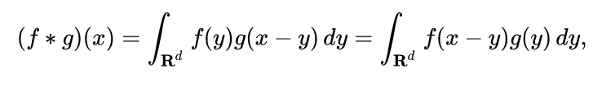
NUMPY ndarray 運算(A矩陣與B矩陣間的convolute運算)
數位訊號以及訊號處理上

Slide 22

Numpy函數中的卷積函式程式庫
a:(N,)輸入的一維陣列
b:(M,)輸入的第二個一維陣列
mode:{‘full’, ‘valid’, ‘same’}
參數可選 ‘
full’ 預設值，返回每一個卷積值，長度是N+M-1,在卷積的邊緣處，信號不重疊，存在邊際效應。
‘same’ 返回的陣列長度為max(M, N),邊際效應依舊存在。
‘valid’ 返回的陣列長度為max(M,N)-min(M,N)+1,此時返回的是完全重疊的點。邊緣的點無效

Slide 23
Full===預設值
import numpy as np
np.convolve([1, 2, 3], [0, 1, 0.5])
np.convolve([1,2,3],[0,1,0.5], 'same')
np.convolve([1,2,3],[0,1,0.5], 'valid')

Slide 24
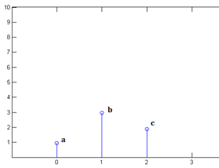
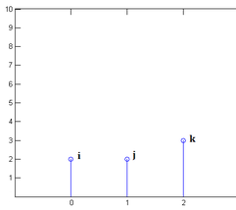
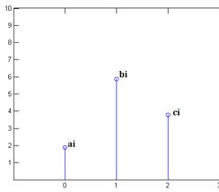
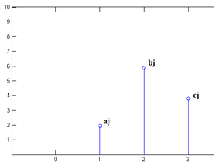
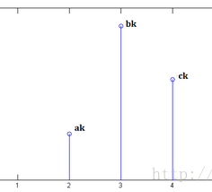
Numpy.convolve(x, y, mode=‘full’)
x[0] = a,x[1]=b,x[2]=c
y[0]=i,y[1]=j,y[2]=k
convolve
x[n]乘以y[0]并平移到位置0
x[n]乘以y[1]并平移到位置1
x[n]乘以y[2]并平移到位置2

Slide 25
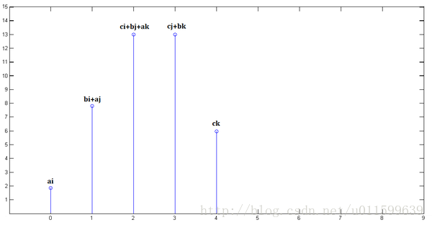
x[n]乘以y[0]并平移到位置0
x[n]乘以y[1]并平移到位置1
x[n]乘以y[2]并平移到位置2
三個圖疊加

Slide 26
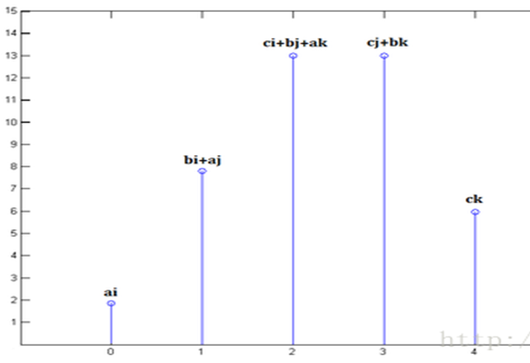
Valid==返回的陣列長度為max(M,N)-min(M,N)+1,此時返回的是完全重疊的點。邊緣的點無效。
Same==>返回的陣列長度為max(M, N),邊際效應依舊存在
Full===預設值，返回每一個卷積值，長度是N+M-1,在卷積的邊緣處，信號不重疊，存在邊際效應

Slide 27
NUMPY ndarray(N-Dimensional Arrays)
檔案輸入與輸出
import numpy as np
x = np.arange(10) 10筆資料
np.save(‘my_array’, x) 接著儲存
np.load(‘my_array.npy’) 輸出
array([0, 1, 2, 3, 4, 5, 6, 7, 8, 9])

Slide 28
NUMPY ndarray 運算 排序sort
import numpy as np
ar=np.array([[3,2],[10,-1]])
# ar
ar.sort(axis=1)
Ar
列數組對調
array([[ 2, 3], [-1, 10]])
import numpy as np
ar=np.array([[3,2],[10,-1]])
# ar
ar.sort(axis=0)
Ar
行數組對調
array([[ 3, -1], [10, 2]])

Slide 29

Numpy technical report
Report completed

Slide 30
1.https://en.wikipedia.org/wiki/Convolution 2.https://github.com/MyDearGreatTeacher/AI4ALL/blob/master/%E8%B3%87%E6%96%99%E5%88%86%E6%9E%90/Numpy%E5%AF%A6%E6%88%B0.md
參考資料

